Slide 1
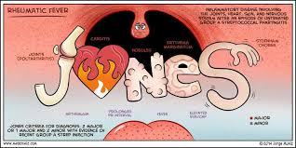
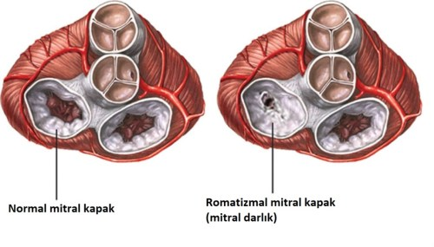
Examination of Platelet Count and Mean Platelet Volume (MPV) Values in Children Diagnosed With Rheumatic Heart Disease
Fatma Zehra Yüksel¹ , Yılmaz Yozgat²
¹Bezmialem Vakıf University Faculty of Medicine, Istanbul, Turkey
²Bezmialem Vakıf University Faculty of Medicine, Department of Pediatry, Division of Pediatric
Cardiology, Istanbul, Turkey
Introduction
Results
Acute rheumatic fever (ARF) is a non suppurative inflammatory connective
tissue disease seen after group A beta hemolytic streptococcal (GAS) infections of the upper
respiratory tract. Long term cardiac damage that can ocur as a result of a single severe attack
or multiple recurrent acute rheumatic fever attacks is called rheumatic heart disease (RHD).
Mean platelet volume (MPV) when evaluated together with the platelet count (PLT), we can
obtain significant results in terms of showing the severity of inflammation in blood. The aim
of our study is to obtain information about the inflammatory process by examining the platelet
counts and mean platelet volume in children with rheumatic heart disease.
A total of 65 patients (39 female and 26 male) diagnosed with rheumatic heart disease
and 67 healthy children (39 female and 28 male ) participated in our study. We compared the
patients group and control group in terms of age, gender, MPV and PLT. The groups were
similar in age and gender(p>0.05). MPV and PLT values of the patients group were lower
than the control group but there was no significant difference between the two groups
(p>0.05).
 | Control Group | Patients Group | P values
Age of child (mean) | 12,52 | 12.65 | 0,93
Gender of child | 39 female 28 male | 39 female 26 male | 0,834
Platelet count (PLT) | 301,1 | 300,82 | 0,79
Mean platelet count (MPV) | 7,55 | 7,46 | 0,795
Conclusion
In our study, the platelet count in the patient group was less than the value we expected. This is because some of the patients are taking medication that can affect the platelet count. We think that blood values ​​taken at the time of diagnosis may be more meaningful in showing inflammation in future studies.
Method
References
In this prospective study, 132 children aged 5-18 years who applied to the pediatric
cardiology department of Bezmialem Vakıf University between June 2020- March 2021 were
included. Echocardiography was perfomed on all participants by pediatric cardiologist. In
both groups, the complete blood was taken and we looked at inflammatory markers (MPV and
PLT) in the blood. We obtained all data from our hospital’s patient data system. SPSS was used for Statistical analysis.
1. Çelik E, Çelik SF. Romatizmal kalp hastalıklarında ortalama trombosit hacmi ve trombosit
dağılım genişliği. Zeynep Kamil Tıp Bülteni; 2018; 49(1) :9-11
2. Karabulut M, Yılmaz E. Akut romatizmal ateş tanılı çocuklarda mpv ve pct
parametrelerinin değerlendirilmesi. Fırat Tıp Dergisi; 2015; 20(4):206-209
3. Ozdemir R, Karadeniz C, Doksoz O, et all. Are mean platelet volume and platelet
distribution width usefull parameters in children with acute rheumatic carditis? Pediatr
Cardiol; 2014; 35: 53-6

